Slide 1

Comparison between ingress controllers and methods to secure web applications in kubernetes clusters
Presenter → Dikshita Kalita
Supervisor → Prof. Dr Martin Leischner
Mentor → Richard Clauß

Slide 2
Agenda
01
Research Questions
02
Comparison of ingress controllers
03
Securing the kubernetes API
04
Demo
Dikshita Kalita | K3s ingress and security

Slide 3
Research Questions
01
What are the most important differences between different ingress controllers?
(Compared implementations: Nginx, Traefik, HAProxy)
2. How can the kubernetes API be secured?
How can users be authenticated and authorized in kubernetes and how do these methods compare against each other?
Which methods exist to integrate identity providers into kubernetes and for which scenarios they are most suitable?
Dikshita Kalita | K3s ingress and security

Slide 4

02
Comparison of ingress controllers
Dikshita Kalita | K3s ingress and security

Slide 5
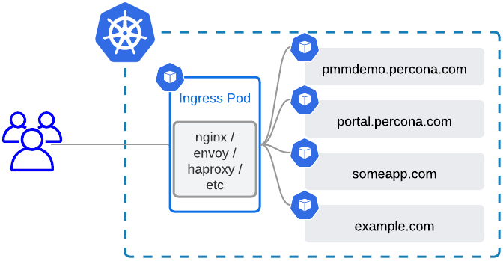
02
Ingress controllers | Introduction | 1
Operates at the application layer and currently only supports HTTP and HTTPS.
All requests are sent to single external IP, which is accessible from outside the cluster
Ingress matches URLs to services
Kubernetes resource IngressClass can define different implementations that can be used in parallel
Dikshita Kalita | K3s ingress and security
Notes:
https://www.percona.com/blog/expose-databases-on-kubernetes-with-ingress

Slide 6
02
Ingress controllers | Types & Comparison
Cloud-based
(configures API Gateway of the cloud)
Types
2. Self-hosted
(hosted as pods inside kubernetes)
Dikshita Kalita | K3s ingress and security

Slide 7
02
Ingress controllers | Types & Comparison
 | IngressNginx | HAProxy (by jcmoraisjr) | Traefik
Based on | nginx | haproxy | traefik
Supported protocols | HTTP 1/2 = tcp HTTP 3 = udp TLS | HTTP 1/2 = tcp HTTP 3 = udp TLS | HTTP 1/2 = tcp HTTP 3 = udp TLSS
Traffic routing capabilities | Host Path Headers Method Query Params | Host Path | Host Path Headers Method Query Params
Authentication
Dikshita Kalita | K3s ingress and security
Notes:
Client does basic auth with server -> basically a http header
Who is server? Application behind nginx or nginx itself?
1. nginx can be configured to be the auth server itself
2. but nginx can also as reverse proxy forward the http header of basic auth to the actual application
3. Nginx can ask a authentication and authorization server for permission to forward the request
In the big table method 1 is meant primarly
But there is a row ExternalAuth, which refers to method 3

Slide 8

02
Ingress controllers | Preference
Best TLS termination and header-based routing
Automatically enables HTTP2 and is better
Built-in Lets Encrypt and supports automatic certificate renewal
High performance and stability
Dikshita Kalita | K3s ingress and security

Slide 9

03
Security in Kubernetes
Dikshita Kalita | K3s ingress and security

Slide 10
03
Security in Kubernetes | Introduction | 1
Image registry
UI
Node 1
Master Node
Node 2
API
CLI
Node 3
.
.
.
Node n
Fig: Architecture in bigger picture
Dikshita Kalita | K3s ingress and security

Slide 11


03
Security in Kubernetes | Access Control | 1
Solution:
TLS
Kubernetes is not a security platform
Authentication
No native tools to handle security-related tasks
Authorization
No vulnerability detection for applications
Admission Control
No monitoring for attacks and breaches
Components to protect:
Cluster
Kube API
Dikshita Kalita | K3s ingress and security
Notes:
Authentication = confirm and find out identity
Authorization = define via policies what an individual identity or group may access
Access control = methods we use to enforce such policies
admission controller= is a piece of code that intercepts requests to the Kubernetes API server prior to persistence of the object, but after the request is authenticated and authorized.
-> one additional layer to extend the (already existing) access control
Source:
https://www.icann.org/en/blogs/details/what-is-authorization-and-access-control-2-12-2015-en
https://www.sailpoint.com/identity-library/difference-between-authentication-and-authorization/

Slide 12





03
Security in Kubernetes | Access Control | 2
TLS
Authentication
Authorization
Admission Control
1. Once we ae inside the cluster, we need to have authorization to even query by: kubectl get nodes (etc.)
1. By default, kubernetes API server listens on port 6443 on the first non-localhost network interface, protected by TLS
1. Once TLS is established, the HTTP request moves to the Authentication step.
1. Additional layer that can be plugged into the security pipeline where we can use mechanisms to manipulate current requests typically when we want to enforce certain defaults within the cluster.
2. This is where kubernetes validates our identity
2. Authorization layer disects our requests into 3 elements and figure out if we are authorized to perform tasks::
2. The API server presents a certificate. This certificate may be signed using a private certificate authority (CA), or based on a public key infrastructure linked to a generally recognized CA.
3. Once identity is proven, the authentication is complete and we are let inside the cluster
Subjects: “user”
Resource: object name that the user is trying to access
Action: what the user wants to do with the resource

Slide 13





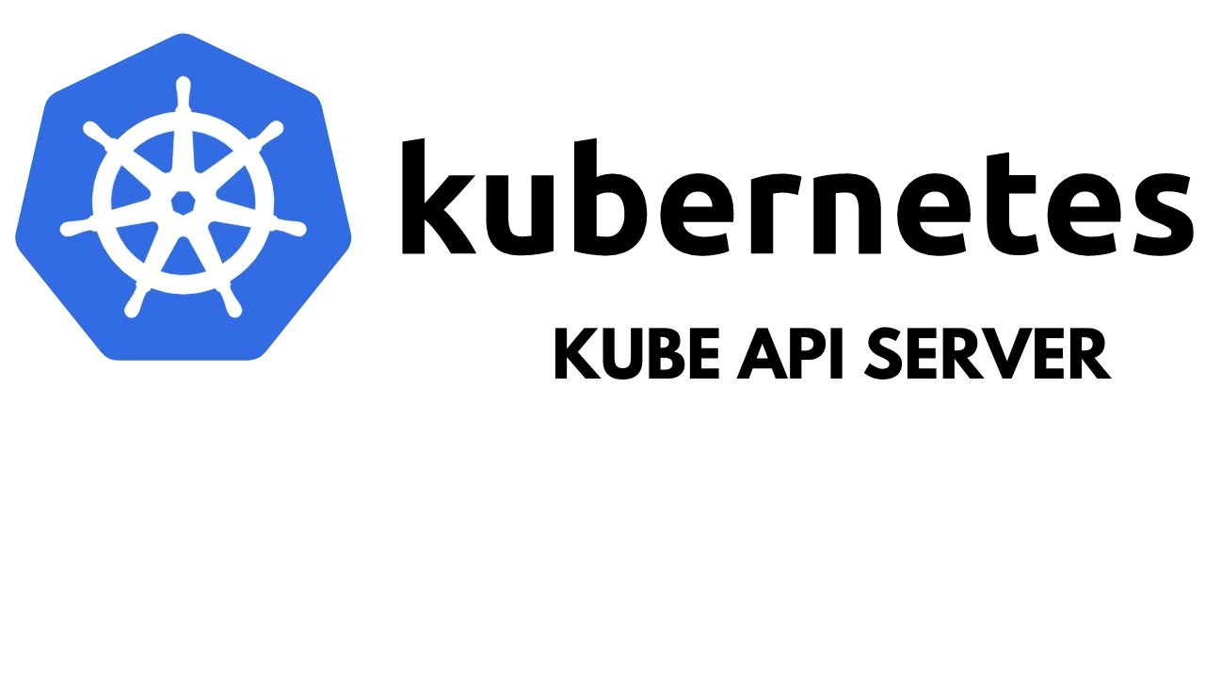
03
Security in Kubernetes | Security Pipeline
Human user
Kubernetes object (s)
Authentication
2. Authorization
3. Admission Control
Pod/ServiceAccount
Fig: Kubernetes security pipeline, Source: Click here
Dikshita Kalita | K3s ingress and security

Slide 14
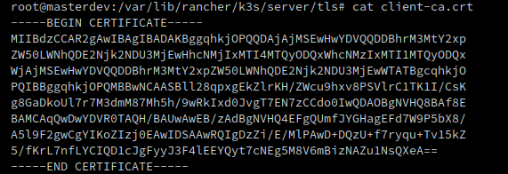
03
Security in Kubernetes | AuthN Strategies
Static Token File
X509 Client Certificates
Dynamically managed Tokens
Pass a CSV with the following:
<token>,<username>,<UID>,”<group1, group2>”
<token>,<username>,<UID>,”<group2, group4>”
OpenID Connect (OIDC)
(HTTP Bearer authentication)
(HTTP Bearer authentication)
Insecure
Not scalable
Long-lived and can’t be revoked effectively
Makes it hard to use groups with RBAC
Dikshita Kalita | K3s ingress and security
Notes:
https://developer.mozilla.org/en-US/docs/Web/HTTP/Authentication

Slide 15

03
Security in Kubernetes | Users
Humans
Service Accounts
Dikshita Kalita | K3s ingress and security

Slide 16

03
Security in Kubernetes | User 1- Humans
Kubernetes does not have
RELIES on a variety of techniques to delegate that
User, profile database / lookup table to store usernames, passwords to store usernames, passwords
Instead
For human users
i.e.
NO API calls to create user
Dikshita Kalita | K3s ingress and security

Slide 17

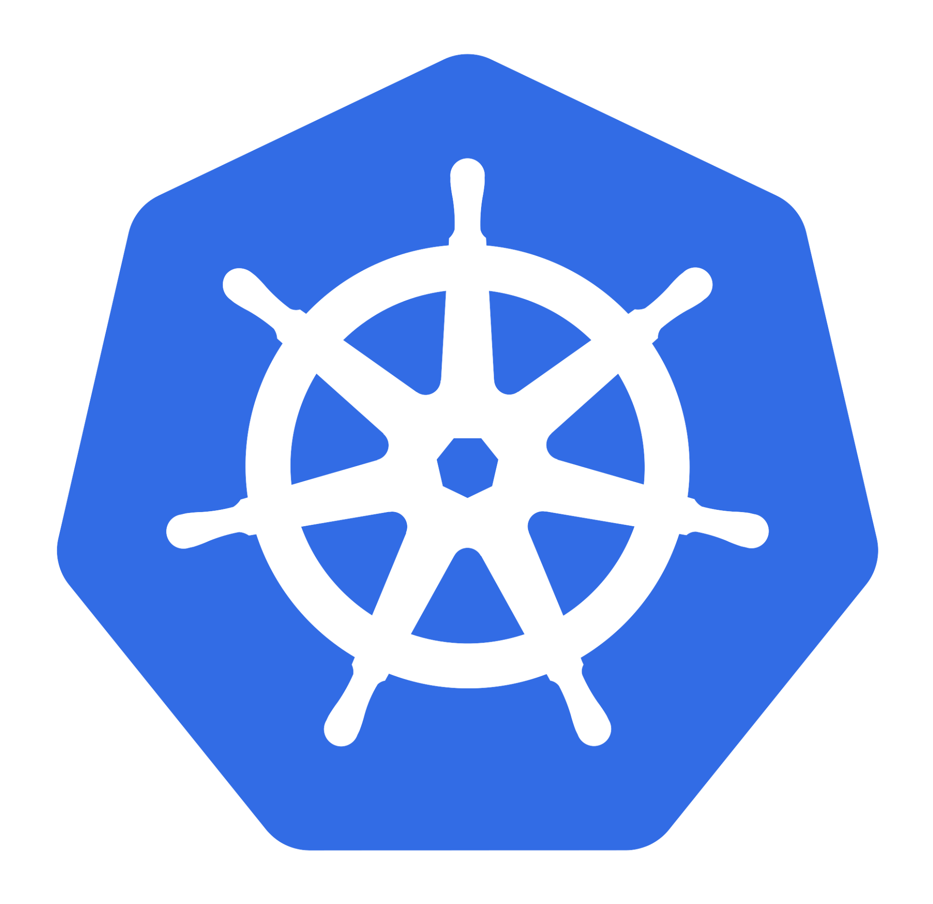

03
Security in Kubernetes | User 2- Pods
Service Account / SA is
1. Internal representation of a set of credentials that are typically stored as Secrets.
Accesses
Through
Service Accounts
2. Pods uses this SA to authenticate when they talk to internal API endpoint
3. By default, SA have no access permissions but can be configured using RBAC to give them access permission and role-based control so they can query and manipulate
Dikshita Kalita | K3s ingress and security

Slide 18
03
Security in Kubernetes | ServiceAccount
Very useful if we have an automatized application set-up in the cluster to deploy the pods after its build up
2. Create a Role:
k3s kubectl apply -f default-role.yaml
3. Create a RoleBinding:
k3s kubectl apply -f role-binding.yaml
Dikshita Kalita | K3s ingress and security

Slide 19

03
Security in Kubernetes | AuthZ Modules
1. It evaluates attributes or characteristics in order to determine the access
AlwaysAllow
Not for production but for specified use-case
2. AlwaysDeny
2. The administrator defines a set of user authorization policies into a file with one JSON per line format.
3. Node
Using this node or kubelet would talk to API server
Any modification in the file requires API server to be restarted.
4. Attribute-Based Access Control (ABAC)
1. Here we define Roles and with these roles a user can access kubernetes objects
5. Role-based Access Control (RBAC)
6. Webhook
We can connect multiple webhooks for authorization
Dikshita Kalita | K3s ingress and security

Slide 20

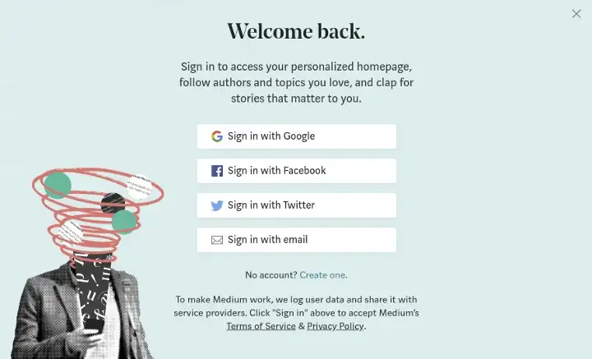


03
Security in Kubernetes | Auth | OIDC
OpenID Connect or OIDC is an identity protocol that utilizes the authorization and authentication mechanisms of OAuth 2.0
2. Easy to use because it sits on top of existing technology OAuth2.0
3. Typical use-case: Identity Federation
Simple identity layer for Authentication
Standard protocol for Authorization
Dikshita Kalita | K3s ingress and security

Slide 21











03
Security in Kubernetes | Auth | OIDC
User
Identity Provider
kubectl
API Server
Login to IDP
Provide access_token,id_token, & refresh_token
Call Kubectl with --token being the id_token OR add tokens to .kube/config
Authorization: Bearer
Is JWT signature valid?
Has the JWT expired? (iat+exp)
User authorized?
Authorized: Perform action and return result
Return result
User
Identity Provider
kubectl
API Server
Dikshita Kalita | K3s ingress and security

Slide 22


03
Security in Kubernetes | OIDC | IdP
A system entity that creates, maintains, and manages identity information for users and also provides authentication services to relying applications.
Does Kubernetes provide an OpenID Connect Identity Provider ?
Solution ?
Dikshita Kalita | K3s ingress and security

Slide 23
03
Security in Kubernetes | OIDC | IdP
We can
Use an existing public OpenID Connect IdP
2. Run our own Identity Provider
Google
Keycloak
Microsoft
Dex
Amazon
CloudFoundry User Account and Authentication
Okta
Tremolo Security's OpenUnison
PayPal
SalesForce
PhantAuth
Github
Dikshita Kalita | K3s ingress and security

Slide 24


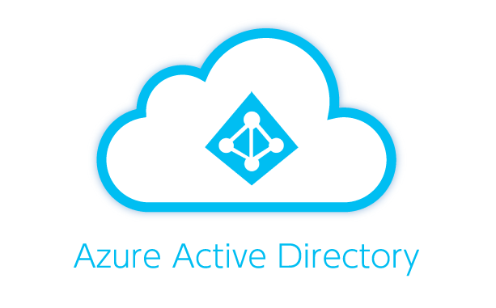


03
Security in Kubernetes | OIDC | IdP
Keycloak
Dex
Complex to operate since it needs standalone database
Simple and easy to set up
Scenario:
Scenario:
Existing IdP
DEX
Keycloak
IdP
OIDC interface
Automated Programming
Dikshita Kalita | K3s ingress and security

Slide 25
03
Security in Kubernetes | Auth | Comparison
 | Kerberos | Lightweight Directory Access Protocol | LDAP | OAuth2.0 | Security Assertion Markup Language | SAML | OIDC
Function | Aids in network authentication | Used for determining any individuals, organizations, and other devices during a network regardless of being on public or corporate internet. It is practiced as Directories-as-a-Service and is the grounds for Microsoft building Activity Directory. | Authorization framework that grants limited access to the user on its account through an HTTP service | XML-based authentication data format which provides authorization between identity provider(Google, AWS, Microsoft Active Directory or Azure) and service provider(Salesforce and other CRM solutions). | Authentication protocol that has API-centered architecture that uses JSON tokens (ID token) and is currently supported by many popular web services, including Google, Paypal, Microsoft and Amazon.
Pros | 1. Supports many OS 2. Authentication key is shared much efficiently than public sharing | 1. Automated protocol which makes it modernize easily 2. Supports existing technologies and allows multiple directories | 1. Simple protocol and is easy to implement 2. Provides server-side authorization of code | 1. Reduced the administrative costs for the end-users 2. Provides SSO for authenticating across service providers | 1. Fast and easy implementation 2. Lightweight and more performance-friendly than SAML 3. Provides a frictionless user experience for mobile and single-page web applications.
Cons | 1. Used only to authenticate clients and services used by them 2. Vulnerable to soft or weak passwords | 1. Directory servers are required to be LDAP obedient for deployment 2. No 2FA 3. Not scalable | 1. Vulnerable to manage different sets of code | 1. Dependent on the identity provider | 1. Still new and evolving and lacks some high-security features that are needed by certain sectors, such as the banking industry.
Dikshita Kalita | K3s ingress and security

Slide 26

03
Security in Kubernetes | Demo
Dikshita Kalita | K3s ingress and security

Slide 27
Resources
https://kubernetes.io/docs/reference/access-authn-authz/authentication/
https://www.tremolosecurity.com/post/kubernetes-dont-use-certificates-for-authentication
https://cloudinfrastructureservices.co.uk/oauth2-vs-openid-whats-the-difference/
https://sysdig.com/learn-cloud-native/kubernetes-security/kubernetes-rbac/
https://www.geeksforgeeks.org/types-of-authentication-protocols/
https://www.strongdm.com/blog/oidc-vs-saml#:~:text=OIDC%3A%20What's%20the%20Difference%3F,to%20obtain%20the%20security%20token.
https://www.varonis.com/blog/what-is-oauth
https://dinika-15.medium.com/identity-federation-a-brief-introduction-f2f823f8795a
https://en.wikipedia.org/wiki/Identity_provider
https://metal-k8s.readthedocs.io/en/latest/developer/architecture/authentication.html
https://medium.com/@sct10876/keycloak-vs-dex-71f7fab29919

Slide 28

Note of gesture
Thank you for your attention and patience

